Slide 1
NON PROFIT DONATION AND FUND MANAGEMENT SYSTEM
TEAM MEMBERS:
ABHILASH
HARSHAVARDHAN
SAMHITHA
TRISHAA
Date-01.12.2023

Slide 2
Introduction
Non-profit organizations (NPOs) play a crucial role in addressing societal issues, advocating for causes, and making a positive impact on communities. As entities that operate for the greater good rather than financial gain, NPOs heavily rely on the support of donors and various funding sources to sustain their initiatives. To effectively manage their operations and ensure transparency, non-profit organizations often implement specialized systems tailored to their unique needs.
Notes:
Introduction
Brief Outline: A summary of what the project is about.
Objectives: High-level goals to be covered in the presentation.

Slide 3
Project Objectives
PROVIDE A SECURE PLATFORM FOR DONORS TO MAKE CONTRIBUTIONS
ENABLE AUTOMATED DISTRIBUTION OF FUNDS TO VARIOUS PROJECTS OR CAUSES
OFFER COMPREHENSIVE REPORTING FEATURES FOR BOTH DONORS AND NON-PROFIT MANAGERS.

Slide 4
Project Objectives
I. Donation Collection
- Facilitate secure and seamless donation processes
- Support various donation channels (online, events, traditional)
II. Transparency and Accountability
- Provide real-time updates on fund utilization
- Maintain detailed records for transparency and audits
III. User-Friendly Interface
- Design an intuitive interface for donors and administrators
- Support one-time and recurring donations
IV. Security and Compliance
- Implement robust security measures
- Ensure compliance with data protection and financial regulations
V. Donor Engagement
- Foster ongoing relationships with personalized communication
- Provide updates on the impact of contributions
NON PROFIT DONATION AND FUND MANAGEMENT SYSTEM

Slide 5
Project Objectives
VI. Multi-Channel Donation Support
- Enable donations through various channels
- Offer multiple payment options for donor convenience
VII. Campaign Management
- Create, track, and manage fundraising campaigns
- Set goals and monitor progress
VIII. Reporting and Analytics
- Generate comprehensive reports for insights
- Aid decision-making with analytics on donation patterns
IX. Integration with Financial Systems
- Integrate with financial tools for seamless fund tracking
- Ensure accuracy in budgeting and financial reporting
X. Comprehensive Record-Keeping
- Maintain accurate records of donations and donor information
- Facilitate auditing and compliance
NON PROFIT DONATION AND FUND MANAGEMENT SYSTEM

Slide 6
Project SCOPE:
I. Project Initiation
II. System Development
III. Infrastructure and Technology
IV. Security Measures
V. Compliance and Legal
VI. User Training
VII. Implementation
VIII. Post-Implementation Support
IX. Continuous Improvement
X. Training and Capacity Building
XI. Emergency Response
XII. Miscellaneous
XIII. Marketing and Promotion
XIV. Environmental Considerations
XV. Monitoring and Evaluation
XVI. Future Phases and Expansions
XVII. Employee Benefits
XVIII. Educational Initiatives
XIX. Cybersecurity Training
XX. Adoption

Slide 7
Project Outcomes:
I. Improved Donation Processing
II. Enhanced Donor Engagement
III. Increased Transparency
IV. Efficient Fund Allocation
V. Accurate Financial Reporting
VI. Compliance with Regulations
VII. Secure Donor Information
VIII. User-Friendly Interface
IX. Increased Scalability
X. Effective Communication
XI. Integrated Systems
XII. Training and Support
XIII. Positive Impact Measurement
XIV. Budget Adherence
XV. Risk Mitigation
XVI. Documentation for Sustainability
XVII. Organizational Growth

Slide 8
Individual Contributions
ABHILASH: CSS , Database, AWS ,documentation
HARSHAVARDHAN: CSS , Database, AWS
SAMHITHA:AWS,WEBPAGE DESIGN
TRISHAA:AWS,WEBPAGE DESIGN,documentation

Slide 9
Project Architecture
Interaction and List of AWS Services USED:
Amazon EC2: To run the donation platform.
Amazon RDS & DynamoDB: To handle transaction records and donor information.
AWS Lambda: For processing donations and issuing receipts.
Amazon S3: For storing transaction records and financial reports.
Amazon SES/SNS: For donor communication and alerts.
Notes:
Project Architecture
AWS Services: List of AWS services used.
Interaction: How these services work together.

Slide 10
Challenges and Solutions
1. Challenge: Scalability
Solution: Use Amazon EC2 instances with Auto Scaling to handle varying loads. DynamoDB's scalability ensures efficient handling of transaction records.
2. Challenge: Ensuring Data Security
Solution: Implement encryption for data in transit and at rest. Regularly audit access controls and perform security assessments. Utilize AWS Identity and Access Management (IAM) for granular control.
Notes:
Challenges and Solutions
Problem 1: Description and resolution.
Problem 2: Description and resolution.

Slide 11
Cost Analysis
1. Cost Optimization:
Leverage AWS Lambda for cost-effective serverless computing.
Use Amazon S3's cost-effective storage classes based on data access patterns.
2. Cost Management:
Utilize reserved instances for Amazon EC2 to reduce compute costs.
Optimize database usage by choosing the right instance types and setting up automated backups.
Notes:
Cost Analysis
Cost Breakdown: Summary of AWS costs.
Budgeting: How costs were managed or optimized.

Slide 12
Security Measures
Authentication:
Strong Password Policies: Implement strong password policies, including minimum length requirements, complexity rules, and regular password expiration. Encourage users to create unique and robust passwords.
Manage user sessions securely by implementing session timeouts, token-based authentication, and secure session storage. Invalidate sessions after a certain period of inactivity to reduce the risk of unauthorized access.
Notes:
Security Measures
Authentication: Steps taken for secure access.
Data Protection: Measures for data security and privacy.

Slide 13
Security Measures
Data Protection:
Data Encryption: Implement encryption for data at rest and data in transit using strong encryption algorithms. This protects sensitive information from unauthorized access both during storage and during transmission.
Notes:
Security Measures
Authentication: Steps taken for secure access.
Data Protection: Measures for data security and privacy.

Slide 14
Lessons Learned
Technical Insights :
1.Database Management: Efficient database management is critical. Knowing how to design and optimize database structures, implement indexing, and handle database backups are essential skills for a robust system.
2. Optimizing AWS Service Utilization: Efficiently utilizing AWS services involves understanding cost-effective configurations, utilizing reserved instances, and optimizing resource allocation for better performance.
3.Webpage Design Best Practices: Creating webpages involves adhering to design principles, ensuring responsive layouts for different devices, optimizing media assets for performance, and utilizing modern frameworks for efficient development.
Notes:
Lessons Learned
Technical Insights: What was learned technically.
Process Insights: What was learned about team collaboration.

Slide 15
Lessons Learned
Process Insights :
Effective Communication Channels: Leveraging effective communication channels, such as video conferencing, collaborative documentation, and instant messaging, fosters clear and timely communication among team members.
Documentation and Knowledge Sharing: Prioritizing comprehensive documentation, including code documentation and system architecture diagrams, facilitates knowledge sharing and onboarding of team members.
Notes:
Lessons Learned
Technical Insights: What was learned technically.
Process Insights: What was learned about team collaboration.

Slide 16
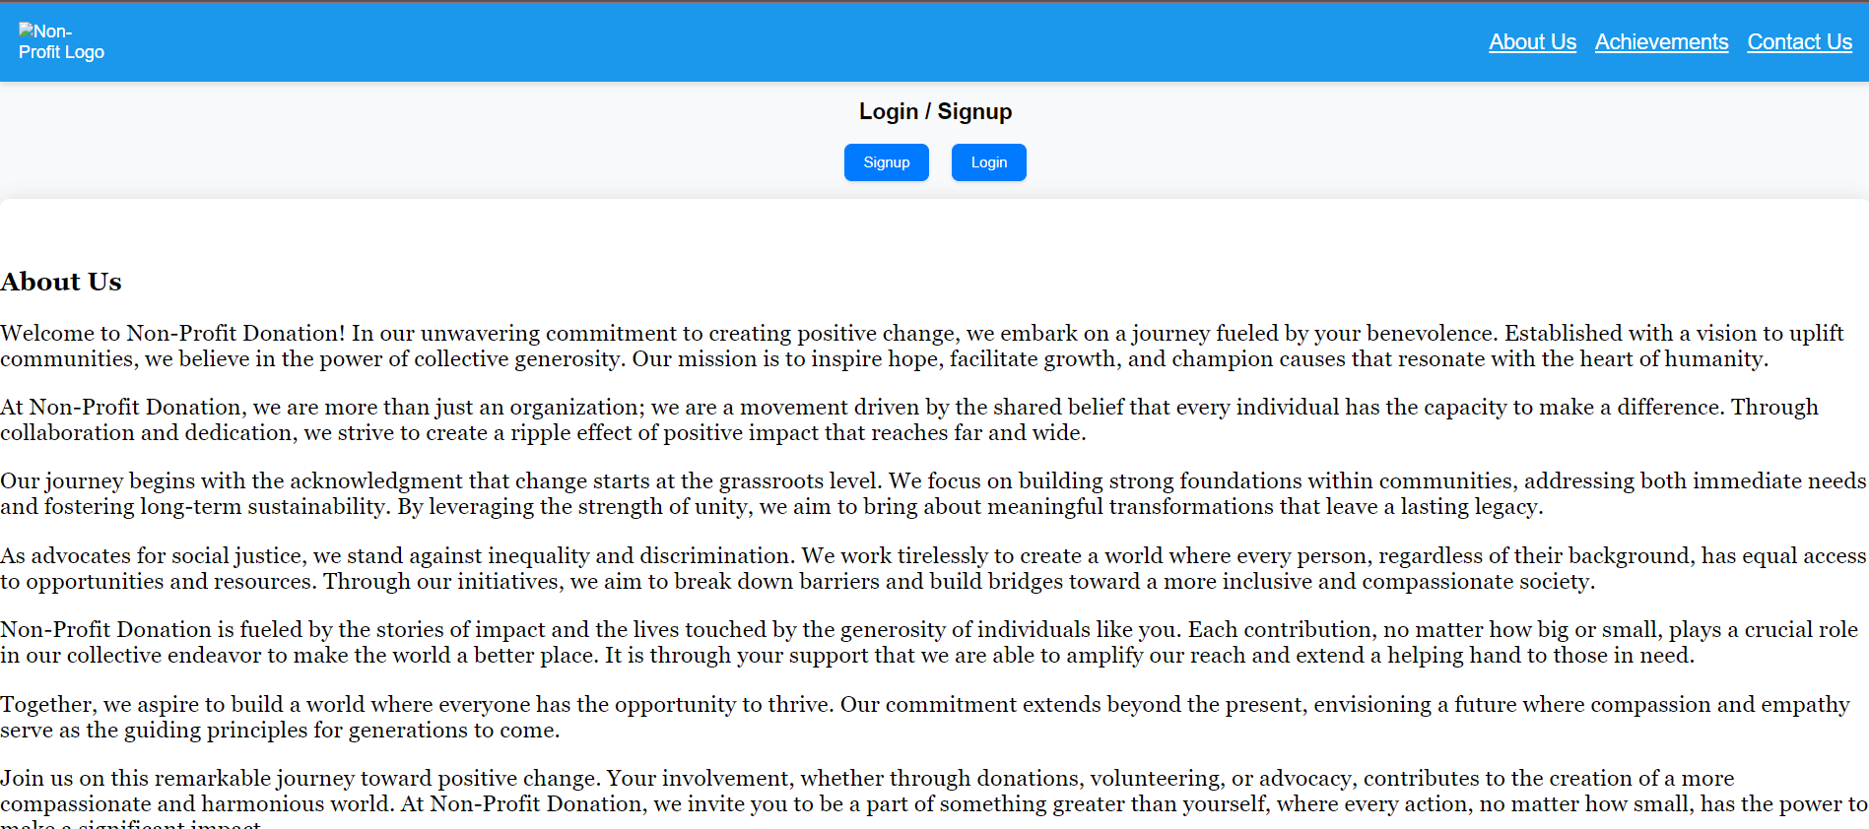
Screenshots: WEBSITE-DETAILS
.
Notes:
Screenshots
Screen Captures: Visual snapshots to showcase key elements.
Context: Description explaining what the screenshot represents.

Slide 17
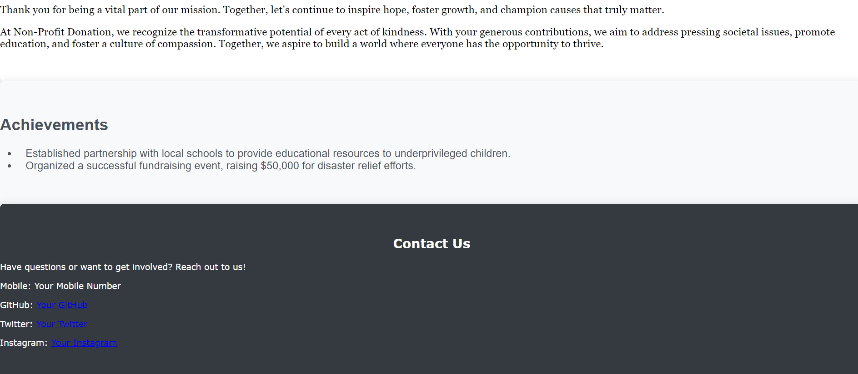
Screenshots: WEBSITE-DETAILS
.
Notes:
Screenshots
Screen Captures: Visual snapshots to showcase key elements.
Context: Description explaining what the screenshot represents.

Slide 18
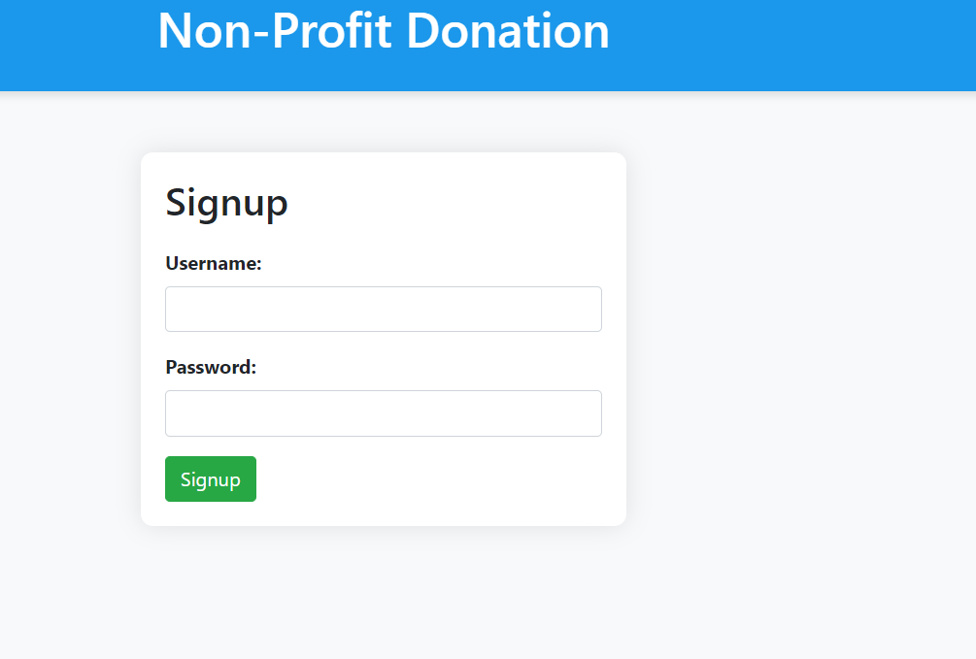
Screenshots: SIGN UP PAGE
Notes:
Screenshots
Screen Captures: Visual snapshots to showcase key elements.
Context: Description explaining what the screenshot represents.

Slide 19
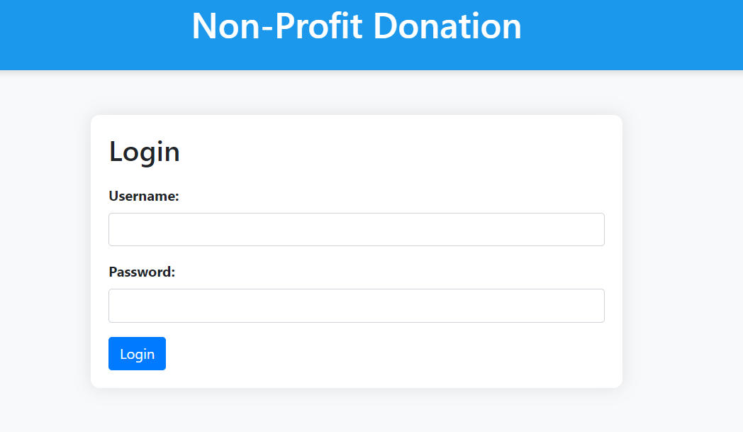
Screenshots: LOGIN PAGE
Notes:
Screenshots
Screen Captures: Visual snapshots to showcase key elements.
Context: Description explaining what the screenshot represents.

Slide 20
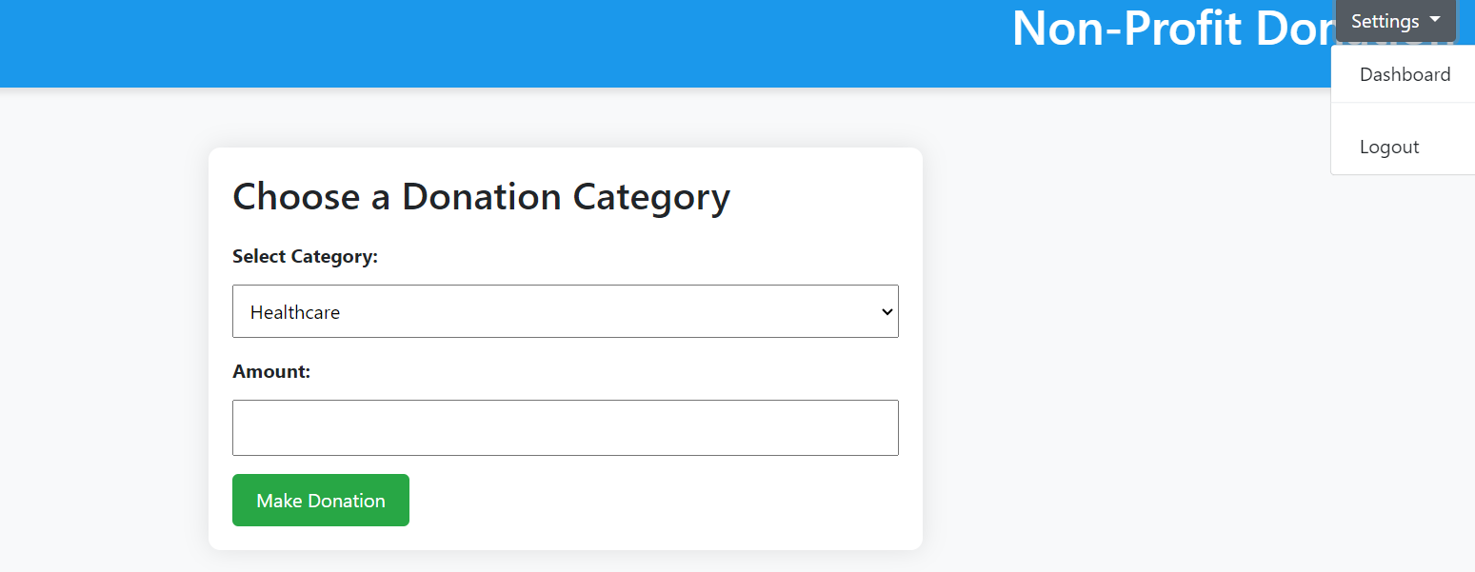
Screenshots: CATEGORY PAGE
Notes:
Screenshots
Screen Captures: Visual snapshots to showcase key elements.
Context: Description explaining what the screenshot represents.

Slide 21
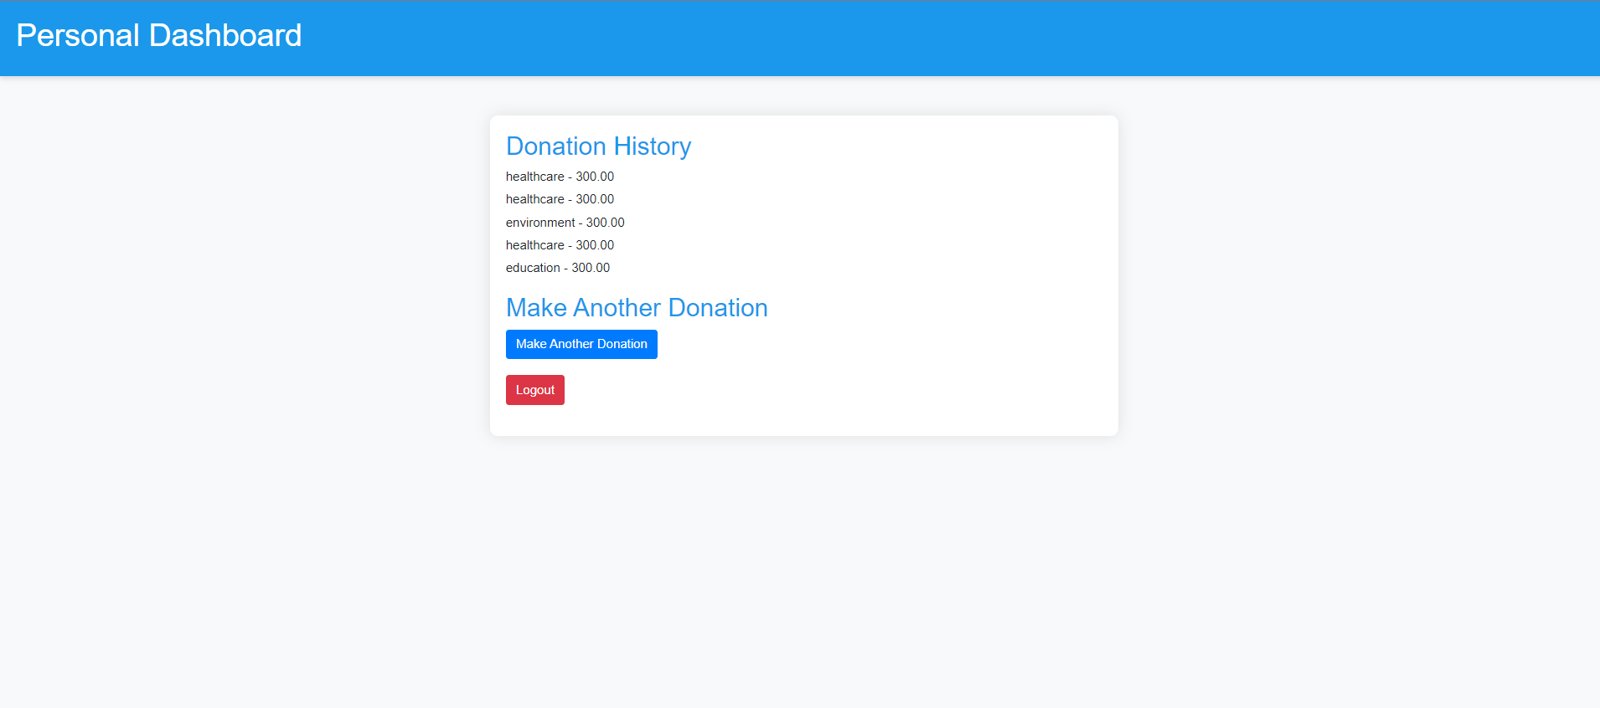
Screenshots: Personal Dashboard
Notes:
Screenshots
Screen Captures: Visual snapshots to showcase key elements.
Context: Description explaining what the screenshot represents.

Slide 22
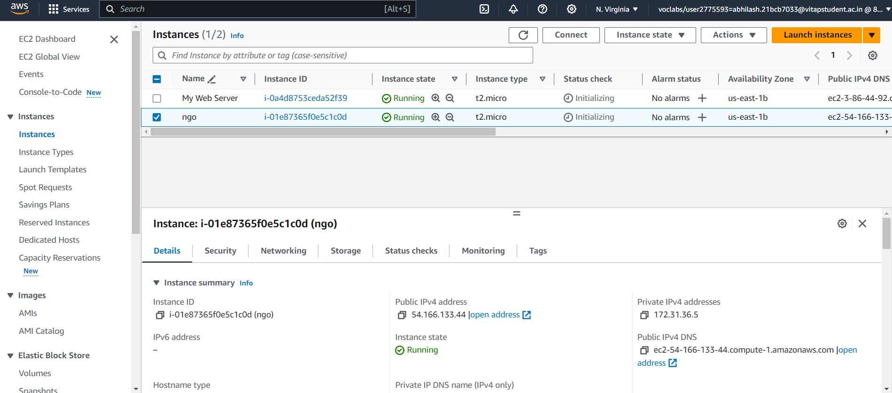
Screenshots: EC2 Instance
Notes:
Screenshots
Screen Captures: Visual snapshots to showcase key elements.
Context: Description explaining what the screenshot represents.

Slide 23
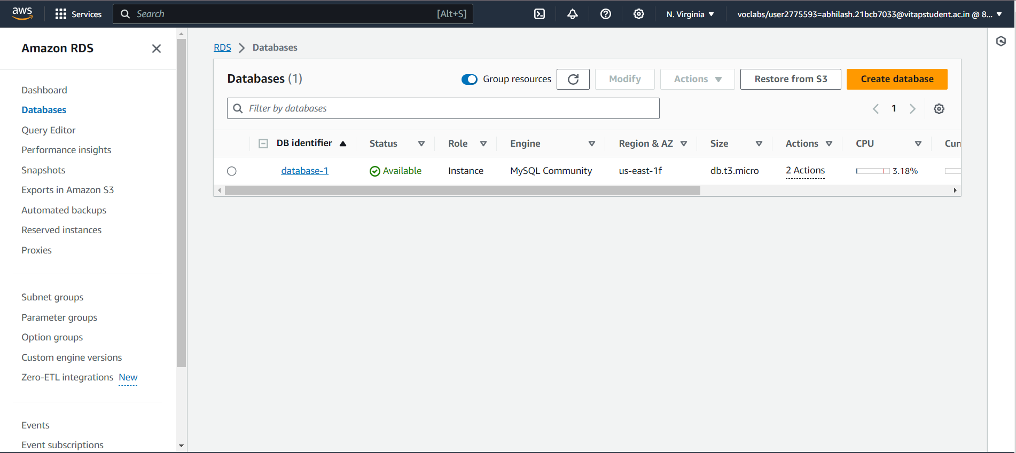
Screenshots: RDS
Notes:
Screenshots
Screen Captures: Visual snapshots to showcase key elements.
Context: Description explaining what the screenshot represents.

Slide 24
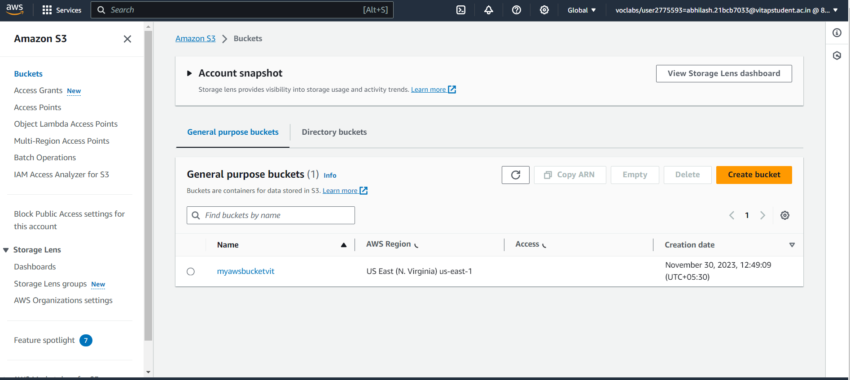
Screenshots: S3 Bucket
Notes:
Screenshots
Screen Captures: Visual snapshots to showcase key elements.
Context: Description explaining what the screenshot represents.

Slide 25
Future Scope
I. Advanced Analytics and Business Intelligence
II. Blockchain Integration for Transparency
III. Mobile App Development
IV. Social Media Integration
V. AI-Powered Donor Insights
VI. Global Payment Gateways
VII. Cryptocurrency Donations
VIII. Crowdfunding Module
IX. Gamification for Fundraising
X. Community Engagement Platform
XI. Automated Grant Management
XII. Environmental, Social, and Governance (ESG) Tracking
XIII. Voice and Chatbot Integration
XIV. Cybersecurity Enhancements
XV. Training and Support for New Features
XVI. Regular Audits
The evolution of a Nonprofit Donation and Fund Management System is an ongoing process, and future phases or expansions can enhance its capabilities, address emerging needs, and adapt to technological advancements.
Notes:
Future Scope
Improvements: Potential updates or add-ons.
Next Steps: Future phases or expansions.

Slide 26
Thank You!
TEAM MEMBERS:
ABHILASH
HARSHAVARDHAN
SAMHITHA
TRISHAA
Notes:
Thank You
Acknowledgments: Thanks to those who contributed.
Contact Info: How to reach the team for further queries.

